Slide 1
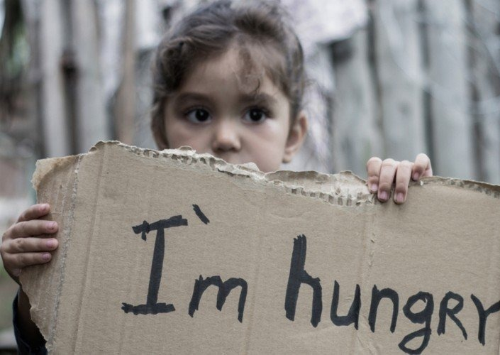
Ideators
Zero Hunger: Food Security
Problem: Millions of people around the world went hungry in 2019. Having nutritious food is a challenge due to high cost and low affordability. Covid19 outbreak has a greater impact on global food systems. Whereas accessibility is challenge and if this trends continue, the Zero Hunger target of the Sustainable Development Goals will not be achieved by 2030.
Source: https://www.unicef.org/reports/state-of-food-security-and-nutrition-2020#

Slide 2
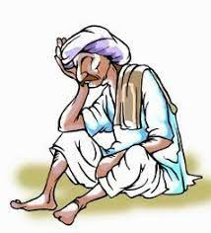
Problem Breakdown
Crop cultivation is being affected due to :
Climatic changes.
Lack of pest control.
Food Wastage are growing due to:
Low-cost estimation in market.
Inappropriate planning in consumption and in production.
Poor Nutrition due to:
Poverty- Unemployment, Low wages.
Lack of quality production- Increased demand of chemical pesticides and synthetic fertilizer.
Food Supply challenges are due to:
Effective support from local community cooperatives(Co-Ops).
Manpower & logistical limitations.

Slide 3
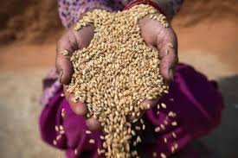

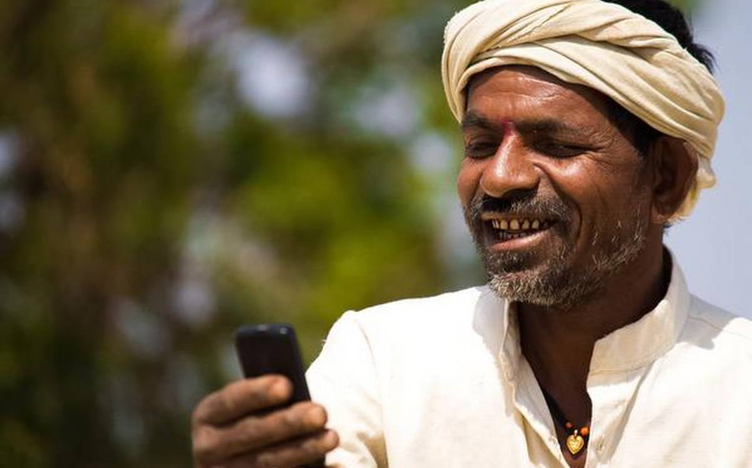
We will solve this: How?
Minimizing the wastage of foods including crops and vegetables.
Recycling of wastage to promote organic farming.
Access to digital wallet through basic phones reachable to remote areas.
Food Security

Slide 4
Ideas to ensure higher food security:
Voice/Text based bots to communicate with farmers for subscription and accessibility to Co-Ops, digital wallet:
On Daily basis farmers will get updates on weather, low-cost pest control, price for their subscribed crops/veg’s based on the locality .
Incase if farmer is going to sell the crops, they need to inform to co-ops before 10days via voice call. So that co-ops can schedule and manage the storage space availability prior to demand.
If the crop storage is reached to 75% they can be moved to other demanding region to avoid wastage of crops.
For this solution we need input from farmer(crop type, approx. date and quantity), storage space of co-ops(daily basis).
Co-ops will manage volunteers/Agency who will collect all surplus vegetables from the farmers and sending those to other demanding regions, food processing industries to prevent wastage. If surplus amount is not likely to sell then will be recycled to make compost, animal food etc.
All the farmer families are entitled to digital wallet and is accessible through sms service.
Reward system to make profitable business in selling surplus food.
What is next?
To make an integrated and digitized system for Co-Ops and Bank/Investors with bots.
To put whole system in blockchain for gaining maximum security and help farmers from getting deprived.

Slide 5















Architecture at ideation phase
Each participant is part of blockchain
Node Red
Communication Platforms
Phone Bots
ML
Independent Farmer
Digital Wallet
Govt/Bank Authorities/Investors.
(Cryptocurrency investor is future)
App UI
Cloud Object Storage
Volunteers/Agencies
Co-op Admin

Slide 6
Business Benefit:
By knowing the demand of all regions, we can prevent the overhead and balance the supply chain. Farmers will get profit, can prevent wastage also the people will get their products who are in need.
This system follows B2B2C model for reducing overhead ,maximizing profit margins.
Opportunities:
Future farming to leverage digitization with the help of modern technologies

